Slide 1

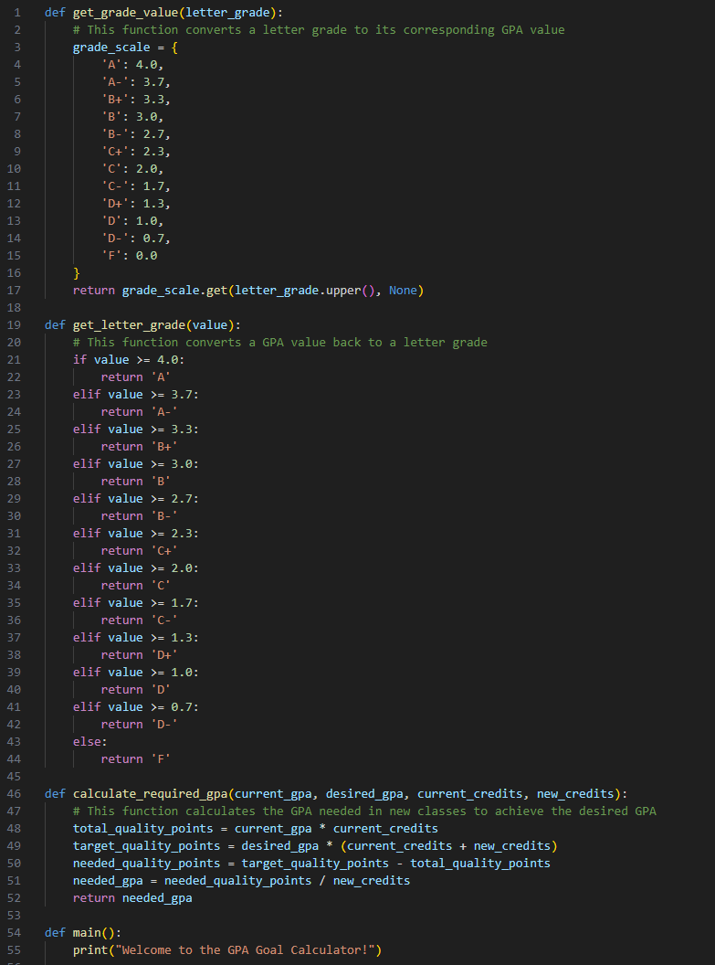
GPA Goal Calculator
Coded by: Destin Yildirim
https://github.com/destinyil/GPA-Goal-Setter
Helping students across the world achieve and maintain their dream GPA!

